Slide 1
Welcome & Module Induction
What we learned previously: In Module 7, we unlocked Python's "Power Tools"—collections, itertools, and Regular Expressions—to handle massive datasets with high speed and memory efficiency.
What we are learning today: We are going to build the "Face" of our software. We will master the art of building Command Line Interfaces (CLIs). We will move from basic argparse to modern frameworks like Click and learn the advanced concept of "Piping" data through Standard Input and Output (Stdin/Stdout).
Why this will be helpful: Professional engineering tools are rarely "clicked" with a mouse; they are triggered via scripts and terminals. Whether you are building a tool to batch-process medical images or a deployment script for a server, a professional CLI allows your software to be automated, colorful, and user-friendly.

Slide 2
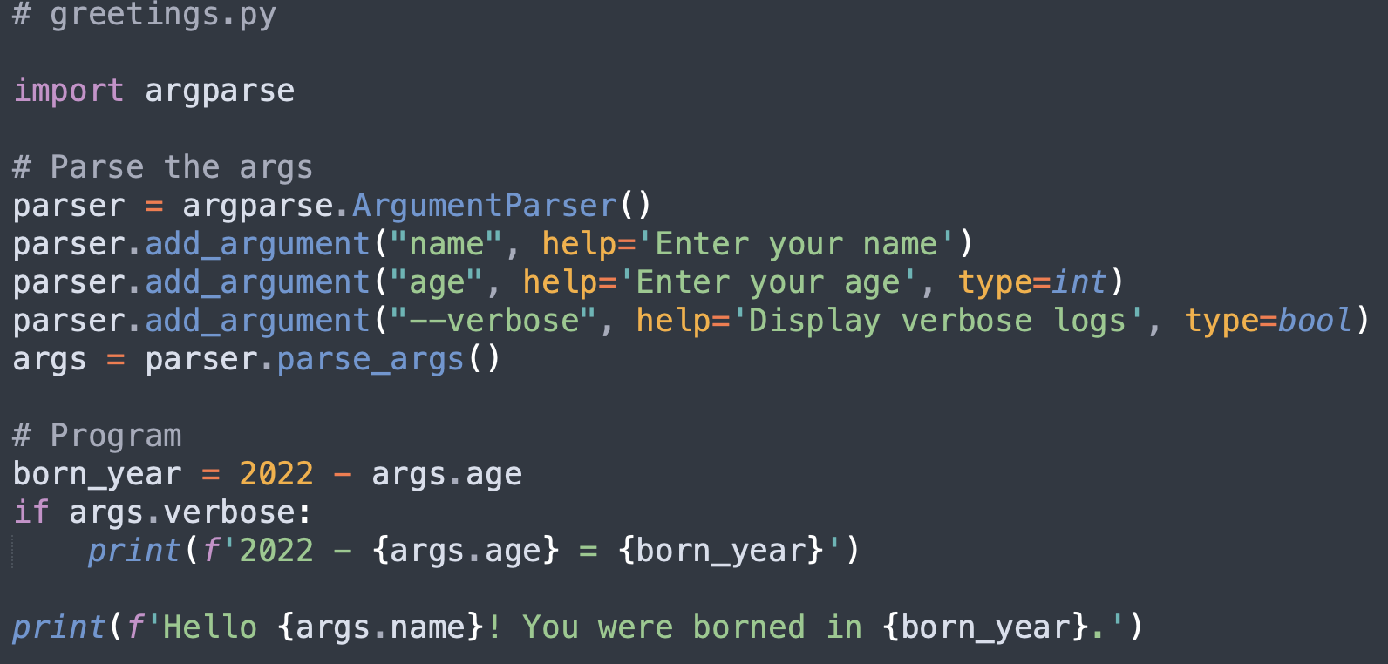
argparse Basics (The Foundation)
The Concept: argparse is the built-in library that lets you pass data into your script at the moment of execution.
Arguments vs. Flags:
Positional Arguments: Required data (e.g., the input filename).
Optional Flags: Modifiers (e.g., --verbose or --output).
Auto-Documentation: By defining your arguments, Python automatically builds the -h or --help menu for your users.

Slide 3

Modern CLI Frameworks (Click & Typer)
Why move beyond argparse? While argparse is powerful, it can become complex and "wordy" for large tools.
Click: A professional framework that uses decorators to wrap your functions. It automatically handles error messages, colorful terminal text, and nested commands (like git add vs git commit).
The "Agile" Feel: These frameworks make your tools feel like expensive, high-end software used in Silicon Valley.

Slide 4
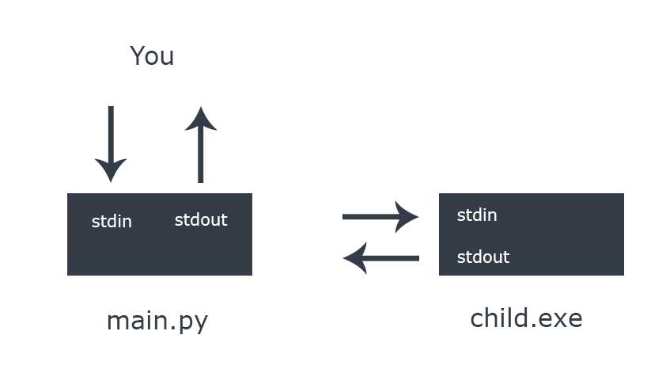
Standard Input/Output (Stdin/Stdout) & Piping
The Flow of Data: In professional Linux/Unix environments, programs are like LEGO bricks. One program's output can be the next program's input.
The Pipe (|): You can "pipe" data into your Python script. For example, cat labels.txt | python my_script.py.
The Logic: By reading from sys.stdin, your script can process live streams of data coming from other programs without ever saving a temporary file.

